Slide 1
5033 C : SWITCH GEAR AND PROTECTION

Slide 2
INTRODUCTION
Switchgear is an integral part of an electric power system.
Switchgear includes series of devices that protect persons and electrical power equipment from effect of faults. Eg : fuses, Circuit breaker ,relays etc..
It is a gear for switching . Switchgear, as the name implies, is a combination of switches, fuses, circuit breakers etc..that control and isolate electrical equipment.

Slide 3
Necessity of Switch gear
Power system must maintain operation 24 hours a day
Voltage and frequency must be in limits
Improve system stability
Minimize damage to electrical equiment
Protection against overloads (over current,over voltage,lightniing )
Ensure safety of person
Enhance electricity availability
To prevent blackouts

Slide 4
Essential features
Complete reliability – Separate faulty part from main system and thus uninterrupted supply through main system
Quick response – Quick response to fault thereby preventing damage spread
Provision for manual control– Manual operations in case of need
Provision for instruments –Provision for connection of instruments like ammeter,voltmeter etc..
Absolute Differentiation – Able to Separate the faulty section and healthy section

Slide 5
Current limiting reactors and its need
It is the most effective current limiting device
The current limiting reactor is an inductive coil having a large inductive reactances and is used for limiting fault currents .Connection in series .
It limits the fault current to flow into the healthy feeders or parts of the system, thereby avoiding the fault from spreading. This increase the chances of continuity of supply.
Reactors are located at different location in a power system for reducing the short circuit current. These reactors may be connected in series with the generators, feeders or in bus-bars

Slide 6
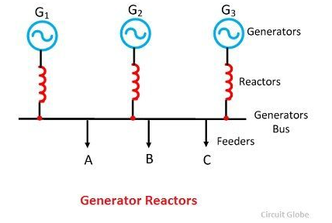
Generator Reactors
Generator reactors are inserted between the generator and the generator bus.

Slide 7
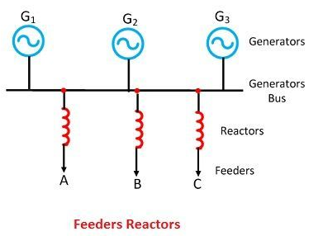
Feeder reactor
Reactors, which is connected in series with the feeder is called feeders reactor.

Slide 8
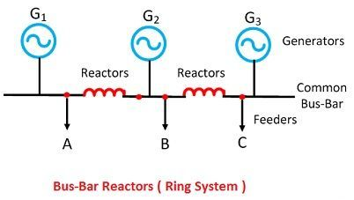
Bus-bar reactor
When the reactors are inserted in the bus bar, then it is called bus-bar reactors.

Slide 9
CIRCUIT BREAKERS

Slide 10
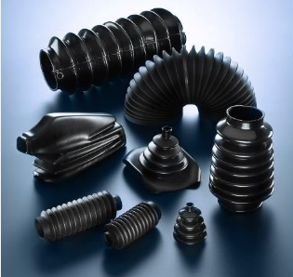
BELLOWS IN SF6 CB(JUST FOR INFORMATION)

Slide 11
FUSES

Slide 12
Fuse is a wire of short length and low melting point to prevent flow of excessive current through the circuit during fault conditions .
Fuse is usually an alloy of tin and lead (37% lead and 63% tin for <10 A )or copper wire(>10 A) .
Have inverse current-time characteristics
Time for blowing out fuse depends on magnitude of fault current.

Slide 13
Desirable characters of Fuse element
Materials used for fuse wire have
Low melting point
High specific resistance material
Low ohmic loss
High conductivity
Free from deterioration(oxidation)
Less co efficient of expansion

Slide 14
Fuse current and factors affecting it
It is the minimum value of current at which fuse wire melts.
Factors affecting Fuse current
Type of material used
The cross sectional area
Length – in small length heat is conducted away easily
Size and location of terminals
Diameter of wire
Type of enclosure used
Type of surface (Fusing current for stranded conductor is less)

Slide 15
Important terms
Current rating –The current which fuse wire can normally carry without melting .
Fusing factor –(minimum fusing current)/(current rating of fusing element)
Value of fusing factor always > unity
Prospective current –It is the dc or rms value of ac which would flow in a circuit immediately following the fuse when a short circuit occurs assuming fuse replaced by a link of negligible resistance .

Slide 16
Continues
Cut off current –The minimum value to which fault current reaches before fuse melts .
Pre arcing time-It is the time between instant of break of fuse wire to the instant arc is initiated .
Arcing time-It is the time between instant of arc initiation to the instant of arc extinguished .
Total operational time –Sum of pre arcing and arcing time .
Breaking capacity-Rms value of ac component of maximum prospective current and system voltage .

Slide 17
Types of fuses
Low voltage fuses
High voltage fuses

Slide 18
Low voltage fuses
Round type Fuse Unit – It has porcelain box and 2 wire terminals for holding fuse wire between them.
Disadvantage
One of terminal always energised and so worker need to open main switch for replacement .
Arcing at time of blowing fuses and after 3 arcing fuse unit is not usable .

Slide 19
2. Rewirable or Kit –kat type fuses – It has Porcelain base for carrying fixed contact to which incoming and outgoing phae wire connected and porcelain fuse carrier for holding fuse element .
Advantages
Easy removal and replacement
Less danger
Disadvantages
Possibility of renewal by wrong wire size
Fuse wire deteriorates with time
Breaking capacity low
Protective capacity is uncertain
Accurate calibration of fue wire is not possible

Slide 20
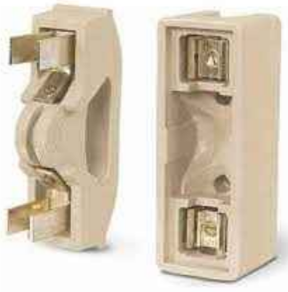

Slide 21
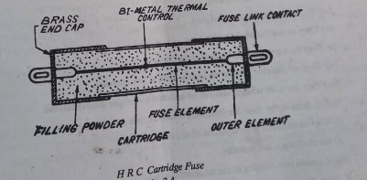
3. Low voltage HRC –High Rupturing Capacity Fuses Cartridge types

Slide 22
Used in large power cases where breaking capacity is high
Construction --It has heat resist ceramic body with brass end cap and fused silver wire is the current carrying element .Fuse wire surrounded by filling powder quartz which is arc extinguishing agent .
Two or more fusing elements can be used for increasing breaking capacity and also silica can be used as arc extinguishing agent .Also in three phase systems tripping device can be employed for continue in supply through non faulty phases .

Slide 23
Working
Pre arcing operation – melting of silver elements
Arcing operation –Vapourization of silver element
Fusion of silver and filling powder and thus a high resistance formed
Extinction of arc under fusion process and thus high resistance converted to insulator and thus fault current interrupted

Slide 24
High voltage HRC fuses
At high voltage there can be problems of corona .So there are two type construction used
Cartridge type – Fuse element in form of helix , also can use high resistance and low resistance fuse element in parallel .These are used upto 33 KV .
Liquid type – Fuse element surrounded by liquid for avoiding corona .For volage transformer protection upto 132 KV ,6100 A.

Slide 25
Applications
Low volatage HRC fuses are used on low voltage distribuition systems against over load and short circuit conditions
High voltage HRC fuse are used for back up protection of Circuit breaker whose capacity increased owing to extended generating plant .It elliminate necessity of replacement of circuit breaker .

Slide 26
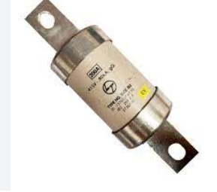

Slide 27
Isolators

Slide 28
Definition
It is a mechanical switch that isolates a part of the circuit from the system when required.
It is also called disconnecting switch
It is used to open a circuit under NO LOAD conditions and they do not have arc quenching devices and usually employed in addition to circuit breaker .
Opening/Closing of circuit- On closing isolator closed first and then circuir breaker .On opening circuit breaker opened first and then isolator.

Slide 29
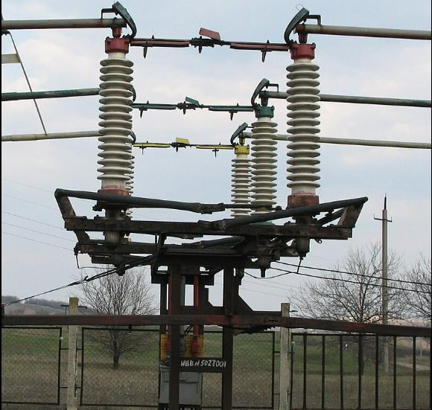
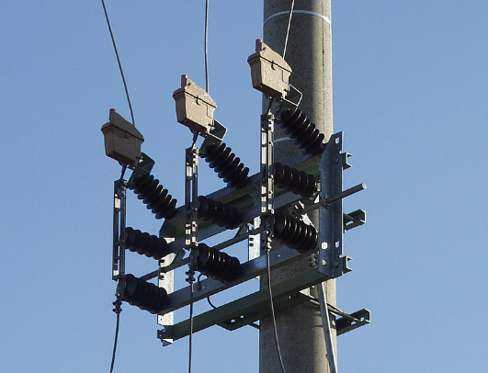

A high voltage and medium voltage disconnector

Slide 30
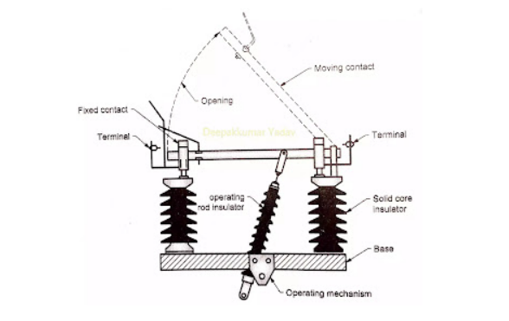
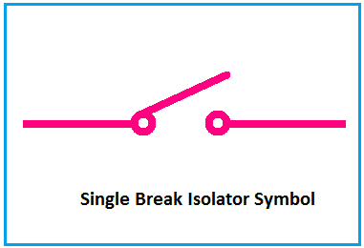
Vertical break type isolator

Slide 31
It has two stacks of insulators which is fixed at both side .
An operating mechanism cause a rod insulator to operate that helps the moving contact to move vertically and there by providing vertical break .
It disconnects or isolates at one side only

Slide 32
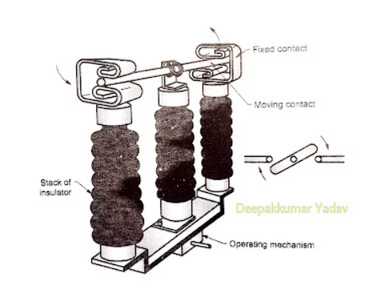
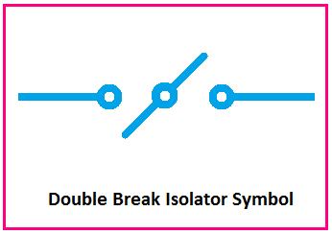
Horizontal break type insulator

Slide 33
It has three stacks of insulators per phase. These insulators are mounted on a galvanised steel frame.
The two insulator stacks at each end are fixed to base and the central insulator is free to rotate around its own vertical axis there by providing horizontal break .
It is designed to connect and disconnect on both two sides.

Slide 34
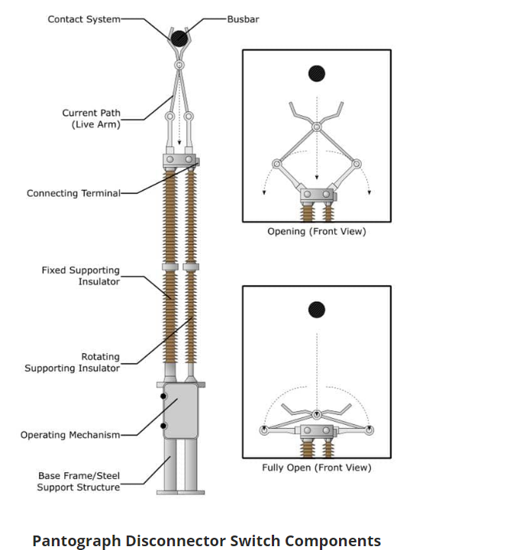
Pantograph type insulator

Slide 35
It has a scissor type arrangement that holds the bus bar.
It has fixed insulator and rotating insulator .The rotating insulator will control movement of arms of the pantograph .
Pantograph Type Isolator is a single break isolator. It constructed with a vertically placed arrangement on a fixed insulator and operated by a rotating insulator. Pantograph type isolator requires a very small place or area and it is very compact and attractive in design.

